Slide 1
JUnit Framework for Testing
Group no. 3 :
Patel Akshaykumar 1116561
Patel Pruthvi 1116564

Slide 2
Introduction
Defining JUnit
Unit Testing & its phases
Why use JUnit & Unit testing
What JUnit Framework does
JUnit Terminologies
JUnit Framework Architecture
Examples
Advantages & Disadvantages
Login web page using Spring boot(Presentation 2 Student 1)

Slide 3
JUnit & Framework
JUnit is open source framework designed in the Java Programming Language.
First JUnit was written by Kent Beck, Erich Gamma in Java .Current Version is 5.5.1 release in July 5 ,2019.
This is also called as Regression-Testing Framework where framework itself provides a way of creating a relationship between development and the testing.
Along with this,it gives surity for modification in code that it will not affect(brake) the system without your knowledge.

Slide 4
Unit Testing & its its phases
Unit testing
ONE FUNCTIONALITY => ONE UNIT TEST
Unit tests are automated and self checked,they work in isolated manner.
In other words,Unit test is a piece of code writtern by developer which targets small units of code, e.g.method or class to ensure that code remains intended.
Three tests phases are Unit testing,Integration testing , System testing

Slide 5
Why JUnit &Unit Testing
Faster Development
Higher Quality
More Flexibility
Easer Development
Test Driven Development

Slide 6
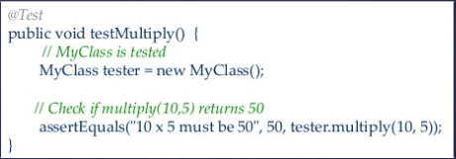
What JUnit Framework does
JUnit runs a suite of tests and report results.
For each test in the test suite,JUnit calls
setUp()
tearDown()
one Test Method

Slide 7
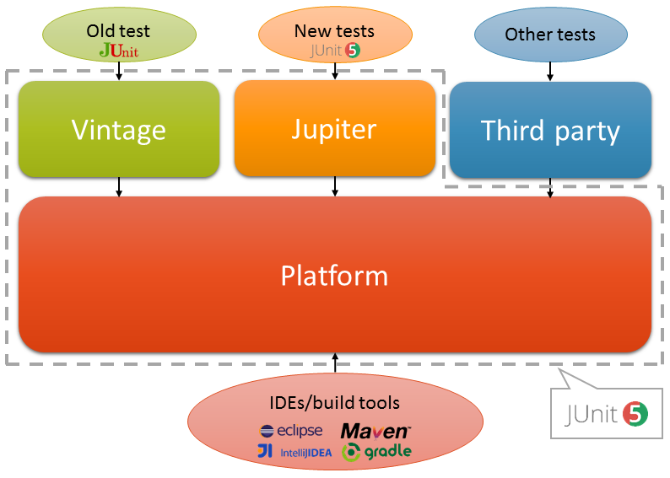
JUnit 5 Architecture

Slide 8
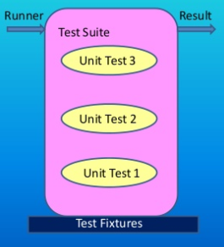
Terminologies in JUnit
Test (@Test , @Before , @After , @BeforeClass , @AfterClass etc.)
Suite (public static Test suite() )
Assert (AssertEquals(),AssertNotEquals())
Runner(Textual & Graphical)
RunListener (TestBegin() & TestEnd() )
Result(Information of Test Cases i.e.,pass,fail or error)

Slide 9
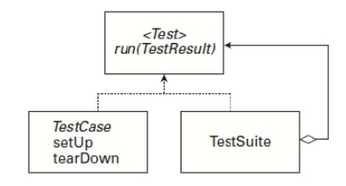
JUnit Framework
junit.framework.TestCase
junit.framework.TestSuite
Example,Writing a test case
public void CalculatorTest extends TestCase { }
public void testAddition(){
Calculator Calc = new Calculator();
int expected = 25;
int result = calc.add(10,15);
assertsEquals (result,expected);
}

Slide 10
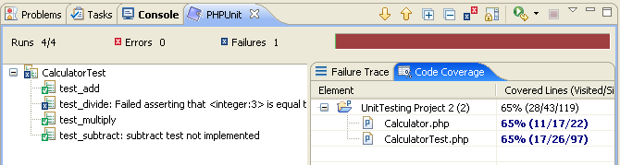
Example:Writing a test case
@Override
protected void setUp(){
calc = new Calculator();
}
@Override
protected void tearDown(){
calc = null;
}
What if this test case Fails?

Slide 11
CONT'D
public void CalculatorTest extends TestCase(){
//Initialize
protected void setUp() ... [A]
public void testAddition() ... [T1]
public void testSubstraction()... [T2]
public void testMultiplication().. [T3]
//cleanup
protected void tearDown().. [B]
}

Slide 12


Example:Writing a test suite
public class AllTest(){
public static Test suite(){
TestSuite suite = new TestSuite();
suite.addTestSuite(<test-1>.class);
suite.addTestSuite(<test-2>.class);
return suite ;
}
}
JUnit has two runners:Textual & Graphical Runner

Slide 13
Example 2
package org.example.antbook.junit;
import junit.framework.TestCase;
public class TestCalculator extends TestCase{
public TestCalculator(String name){
super(name);
}
Calculator calculator; /** @throws java.lang.Exception *\
protected void setUp() throws Exception {
calculator = new Calculator();
}
protected void tearDown() throws Exception{
//int sum = calculator.add(6,7);
//assertEquals(sum,15);
assertEquals(15,calculator.add(8,7));
}
}

Slide 14
Sample Assertions
static void assertEquals(boolean expected,boolean actual)
static void assertEquals(byte expected,byte actual)
static void assertEquals(char expected,char actual)
static void assertEquals(double expected,double actual,double delta)
static void assertEquals(float expected,float actual,float delta)
static void assertEquals(int expected,int actual)
For Complete directory,see
https://junit.org/junit5/docs/5.0.1/api/org/junit/jupiter/api/Assertions.html

Slide 15
Advantages & Disadvantages
Alternate frond ends to display results of tests are available.
Seperate class loaders for each test to avoid side effects.
Provides methods like setUp and teardown
Huge set of assert methods to check results of tests.
Integration with popular tools such as Ant and Maven and IDE's like Eclipse & Jbuilder.
Dependency testing is not provided by Junit
Not suitable for higher level testing

Slide 16
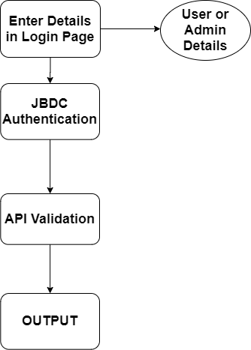
Login Application using Spring Boot

Slide 17
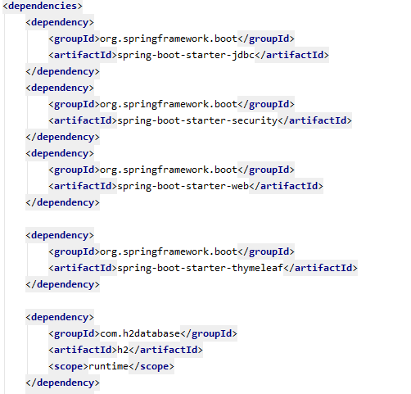
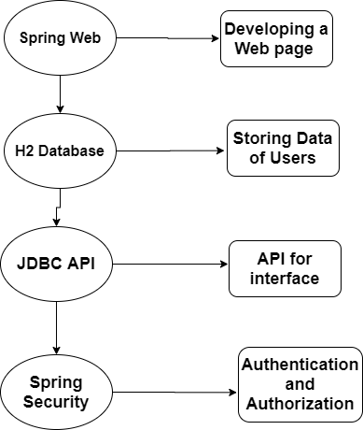
Dependencies

Slide 18
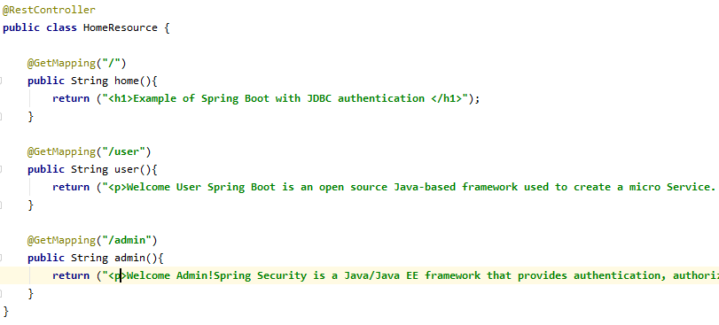
Rest Controller

Slide 19
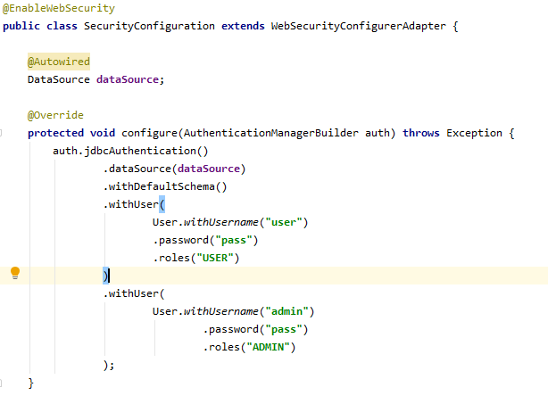
Security Configuration(Authentication)

Slide 20
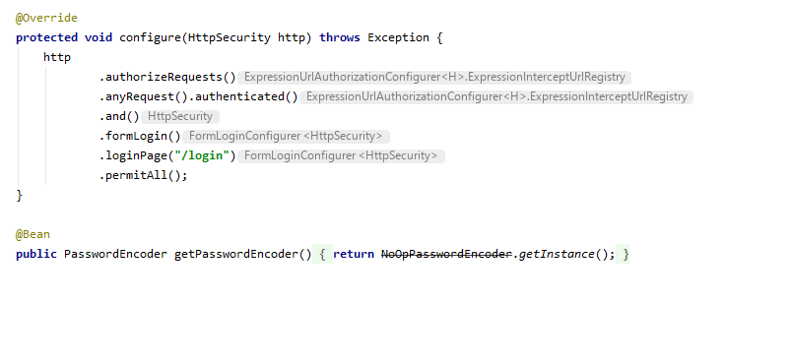
Security Configuration(Authorization)

Slide 21
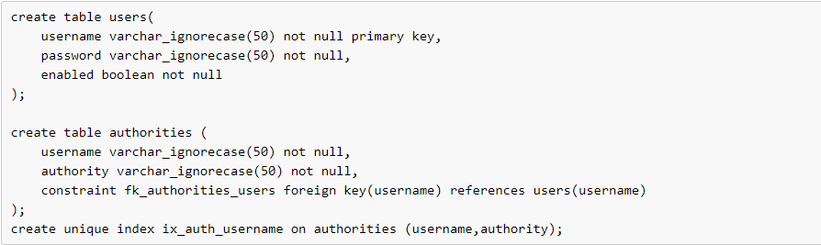
User Schema
JDBC user schema

Slide 22
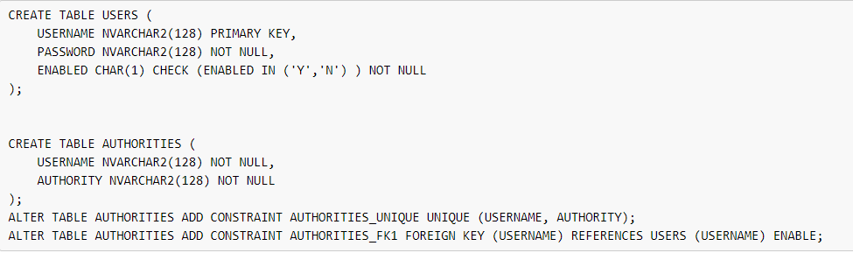
User Schema(Contd.)
Oracle database

Slide 23
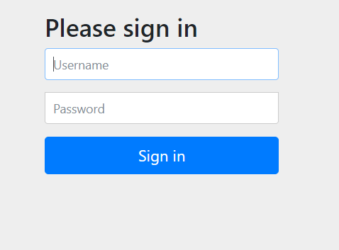
Output Image(Default)

Slide 24
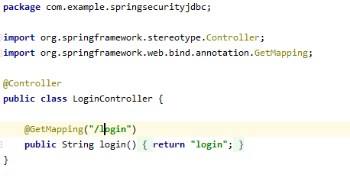
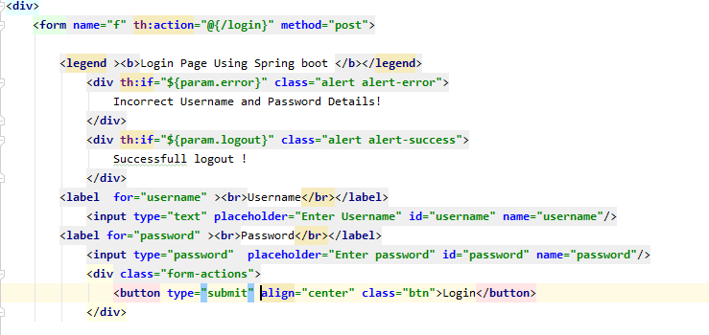

Slide 25
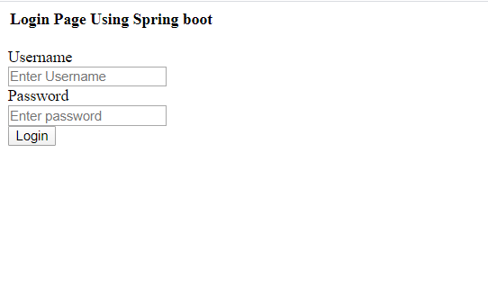
Contd.(Login Page)

Slide 26
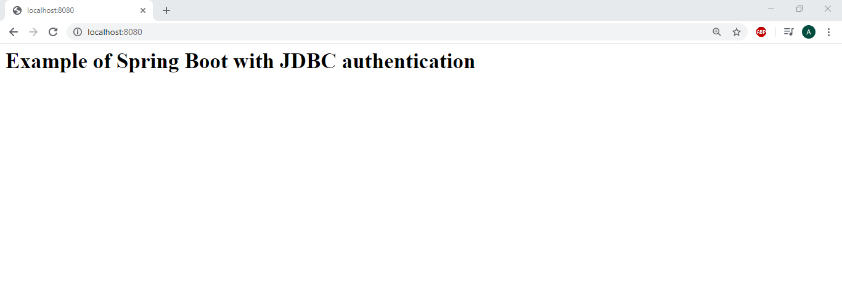
Main Page(Root URL)

Slide 27
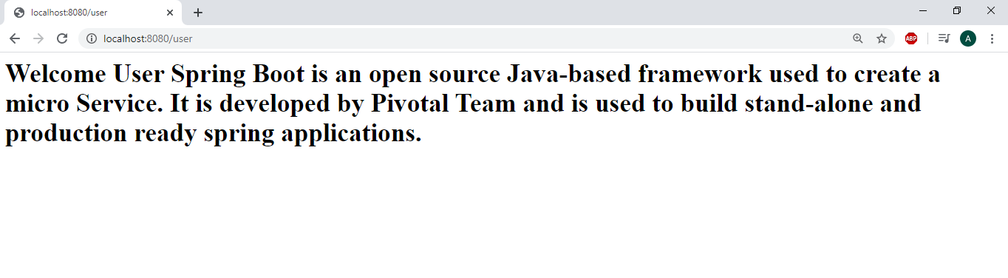
User Login

Slide 28
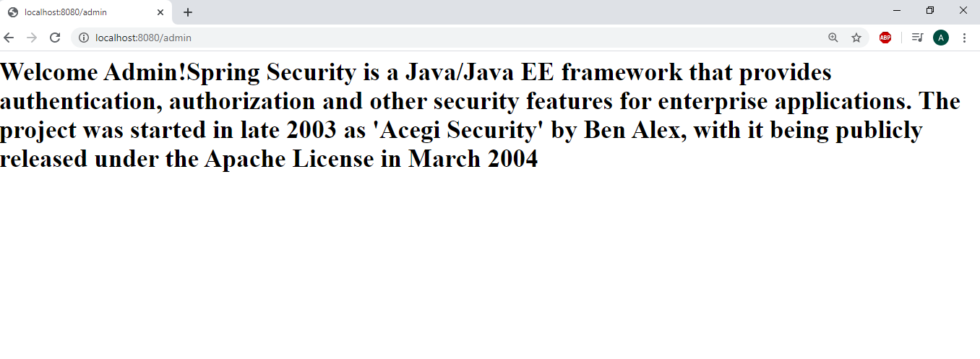
Admin Login

Slide 29
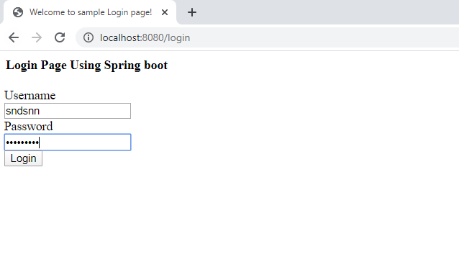
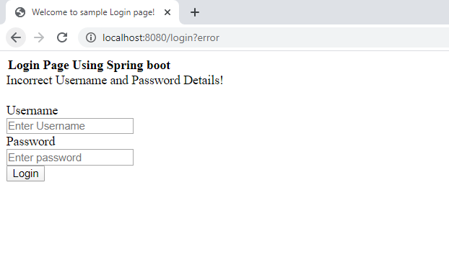
Login Failure

Slide 30
References
https://junit.org/junit5/
https://junit.org/junit4/faq.html
http://www.cs.umanitoba.ca/~eclipse/10-JUnit.pdf
https://www.vogella.com/tutorials/JUnit/article.html
https://supportweb.cs.bham.ac.uk/documentation/tutorials/docsystem/build/tutorials/junit/junit.pdf
http://junit.sourceforge.net/javadoc/junit/framework/
https://testng.org/doc/documentation-main.html
https://www.w3schools.com/howto/howto_css_login_form.asp
https://www.thymeleaf.org/documentation.html
https://docs.spring.io/spring-security/site/docs/current/reference/htmlsingle/#user-schema
https://spring.io/projects/spring-security

Slide 31
Thank You ? If any

